Slide 1

Hadrons in Dense Nuclear Matter
NICA-simul MiniWorkshop 2017

Slide 2
Content
Motivation
Hadrons in Nuclei
  Strongly correlated quark model (SCQM) of the hadron structure
  Building the nuclear structure
Hadron modifications in a dense nuclear matter
Understanding of exp. effects
  Strange meson production, Horn-effect
  Hyperon production
  Dilepton production
Conclusion
Notes:
In heavy ion collisions, and in particular when a QGP is formed, it has long been predicted
that there should be no polarization [9–11]. The essence of the models is that when a QGP has
been formed, a hyperon (for example, a ) would be formed by coalescence of three random
u, d and s quarks. The spins therefore have no preferred axis, and there is no net polarization.

Slide 3
Motivation
How nuclear matter behave under high compression?
How hadrons structures are modified in dense matter?

Slide 4
The Model:
Strongly Correlated Quark Model of Hadron Structure
G. Musulmanbekov, 1995

Slide 5
Constituent Quarks
Current Quarks
Constituent Quarks – Solitons!
Strongly Correlated Quark Model

Slide 6
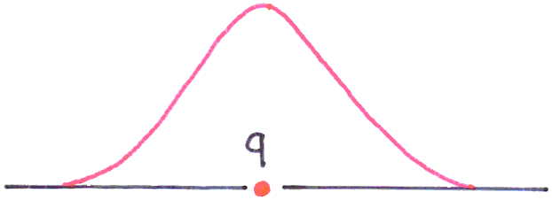
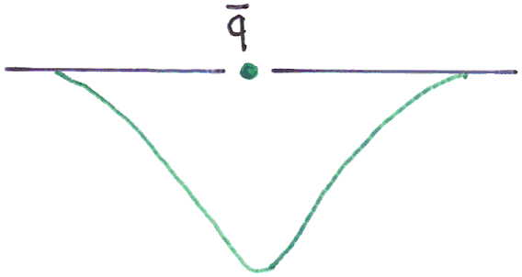
Strongly Correlated Quark Model (SCQM)
ϕ (x)
Vacuum fluctuations
(radiation) pressure
Vacuum fluctuations
(radiation) pressure
Vacuum polarization
around single quark
Quark and Gluon
Condensate

Slide 7
What is Chiral Symmetry and its Breaking?
Chiral Symmetry
SU(2)_{L} × SU(2)_{R} for ψ_{L,R} = u, d
The order parameter for symmetry breaking is quark or chiral condensate:
<ψψ> ≃ - (250 MeV)³, ψ = u,d
As a consequence massless valence quarks (u, d) acquire dynamical masses which we call constituent quarks
M_{C} ≈ 350 – 400 MeV

Slide 8
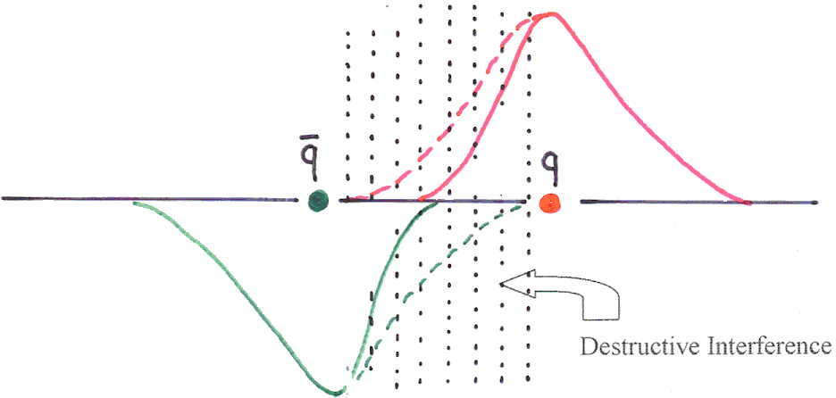
Strongly Correlated Quark Model (SCQM)
Attractive Force
Attractive Force

Slide 9
The Strongly Correlated Quark Model
Hamiltonian of the Quark – AntiQuark System
, are the current masses of quarks,
β = β(x) – the velocity of the quark (antiquark),
is the quark–antiquark potential.
is potential energy of a quark.

Slide 10
Constituent Quarks – Solitons
SCQM ≡ Breather Solution of Sine- Gordon equation
Breather – oscillating soliton-antisoliton pair, the periodic solution of SG:
is identical to our quark-antiquark system;
is Lorentz invariant

Slide 11
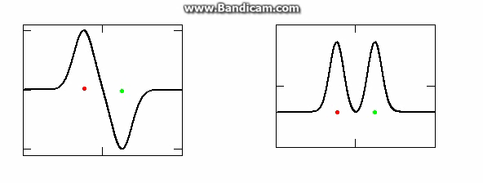
soliton – antisoliton pair
quark – antiquark pair
U_{q} = m∙tanh2(αx) W. Troost, CERN Report, 1975 P. Vinsarelly, Acta Phys. Aust. Suppl., 1976
“The wave packet solution of time-dependent Schrodinger equation for harmonic oscillator moves in exactly the same way as corresponding classical oscillator”
E. Schrodinger, 1926

Slide 12
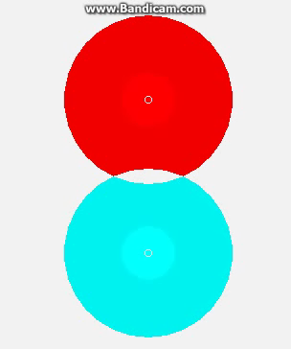
quark–antiquark pair
meson
Exchange by gluons

Slide 13
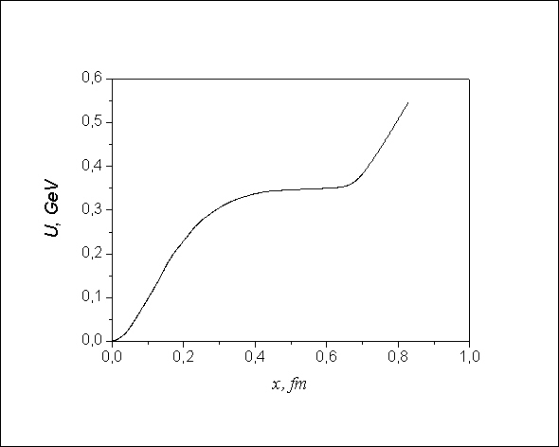

Quark Potential
Uq = 0.36tanh2(αx)
Uq ∼ kx

Slide 14
Generalization to the 3 – quark system (baryons)

Slide 15
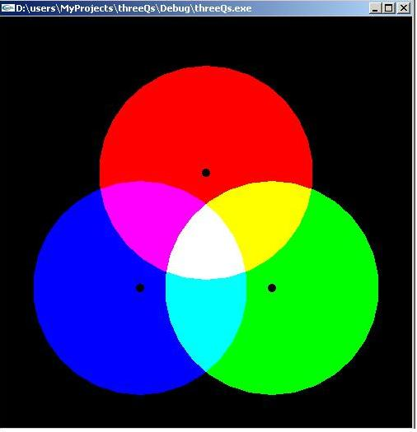
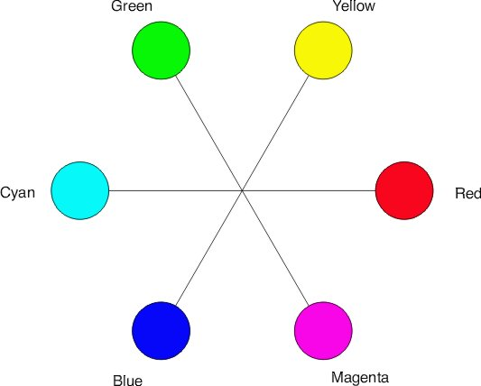
Color Symmetry
SU(3)_{COLOR}
RGB

Slide 16
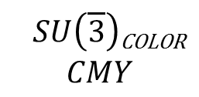
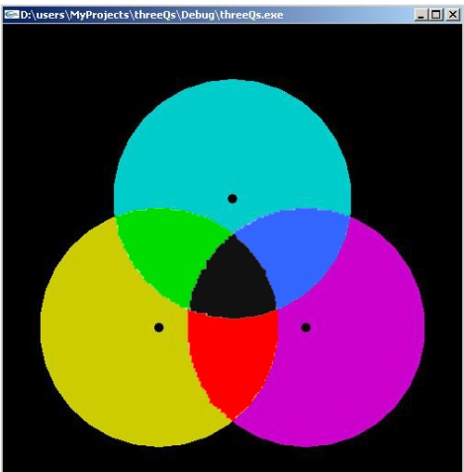
Color Symmetry

Slide 17
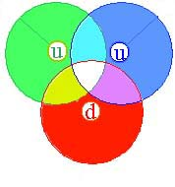
Nucleon
Quark color wave function
Where are orthonormal states with i,j = R,G,B
Nucleon wave function

Slide 18
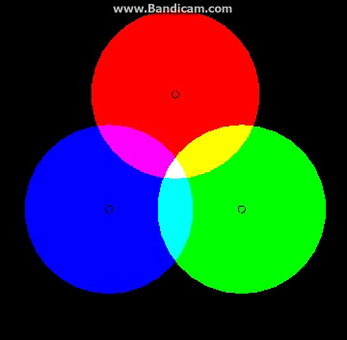
Nucleon
Сolor singlet

Slide 19
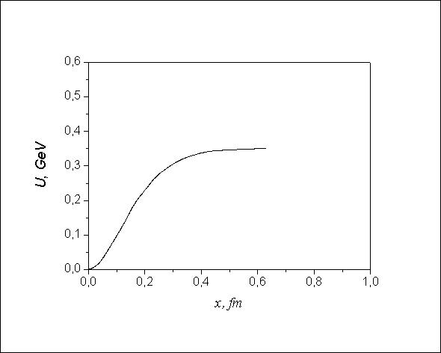
Quark Potential
I
II
U(x) > I – constituent quarks
U(x) < II – current (relativistic) quarks

Slide 20
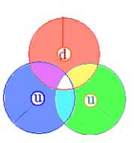
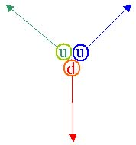
Chiral Symmetry Breaking Restoration
t = 0
x = x_{max}
t = T/4
x = 0
t = T/2
x = - x_{max}
Constituent quaks current quarks Constituent quarks
Asymptotic freedom
During the valence quarks oscillations:

Slide 21

Interplay between current and constituent quarks

Slide 22
SCQM The Local Gauge Invariance Principle
Destructive Interference of color fields ≡ Phase rotation of the quark w.f. in color space:
Phase rotation in color space dressing (undressing) of the quark ≡ the gauge transformation
here

Slide 23
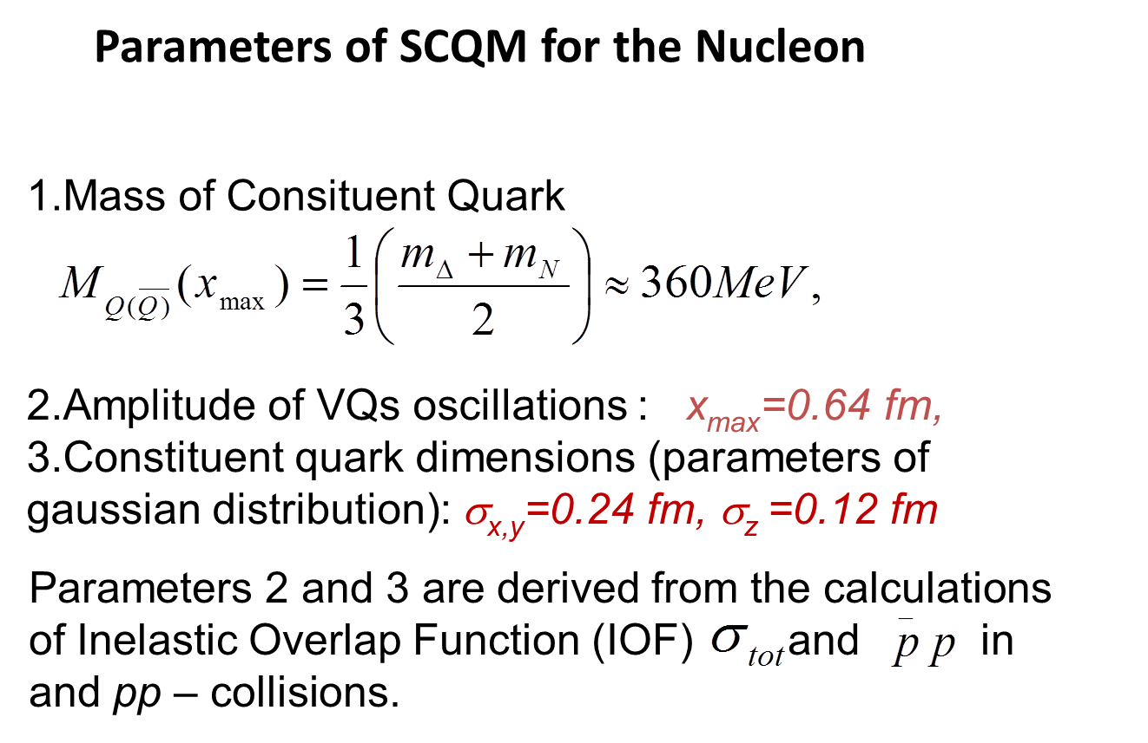

Slide 24
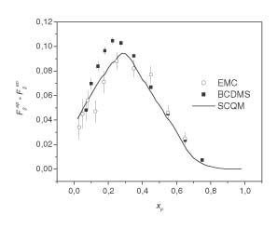
Structure Function of the Valence Quark in Proton

Slide 25
Spin in SCQM
Our conjecture: spin of consituent quark is entirely analogous to the angular momentum carried by classical circularly polarized wave:
Classical analog of electron spin – F.Belinfante 1939; R. Feynman 1964; H.Ohanian 1986; J. Higbie 1988.
Electron surrounded by proper E and B fields creates circulating flow of energy:
S=ɛ₀c²E×B.
Total angular momentum created by this Pointing’s vector
is associated with the entire spin angular momentum of the electron.

Slide 26
Spin in SCQM
Now we accept that
and intersecting E_{ch} and B_{ch} create around VQ color analog of Pointing’s vector
S=ɛ₀c²E×B.
2. Circulating flow of energy carrying along with it hadronic matter is associated with hadronic matter current.
3. Total angular momentum created by this Pointing’s vector
is associated with the entire spin angular momentum of the constituent quark.

Slide 27
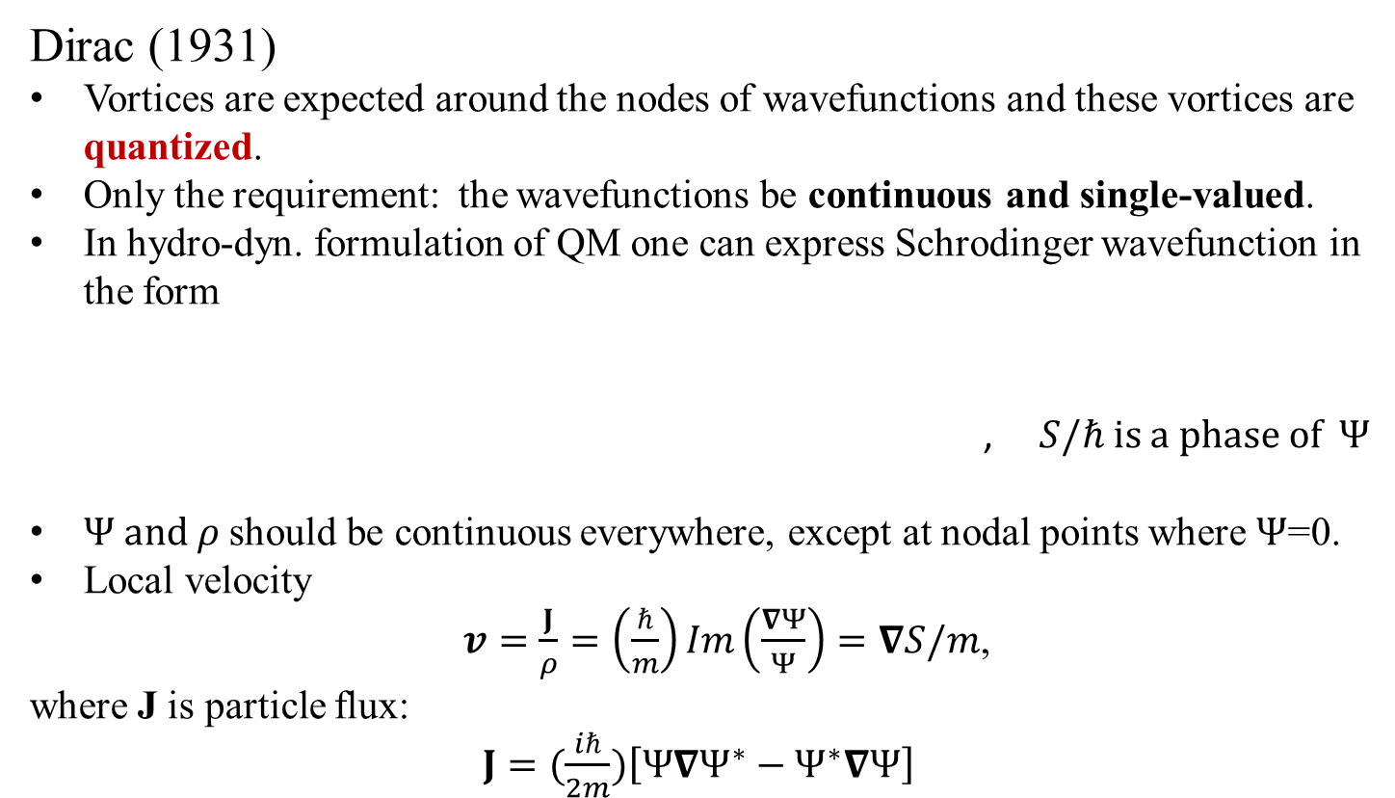

Quantized Vortices

Slide 28
Quantized Vortices
Circulation integral
If loop does not encloses the node,
If it encloses the node, then

Slide 29
Proton Spin in DIS
Source of “Spin Crisis”:
Velocity field in vortex field is irrotational:
If the virtual wave-length encloses the quark hole, then
If the virtual wave-length does not encloses the quark hole, then
Proton Spin in DIS by SCQM

Slide 30
Quarks – Oscillating Vortices
t = 0
x = x_{max}
t = T/4
x = 0
t = T/2
x = x_{max}
Consituent Quarks Current Quarks Consituent Quarks
In the current quark state E_{ch} and B_{ch} are concentrated in a small radius shell around VQ.
And so is for the hadronic current.

Slide 31
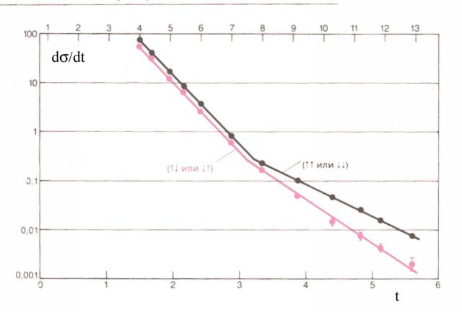
Polarized proton-proton collisions
anti-parallel spins
parallel spins
“Krish” - effect

Slide 32
Collision of Vorticing Quarks
Spin Asymmetries
Anti-parallel Spins
Parallel Spins
“Krish” - effect

Slide 33
Summary on Quarks in Hadrons
Constituent quarks are identical to solitons.
Quarks and gluons inside nucleons are strongly correlated;
Hadronic matter distribution inside hadrons is fluctuating quantity;
Nucleons are not spherically symmetric (deformed).

Slide 34
Quark Arrangement inside Nuclei
Nuclear Models
Strongly Correlated Quark Model
Crystal-like arrangement of Nuclear Structure

Slide 35
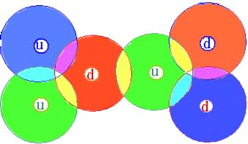
Two Nucleon System in SCQM
Selection rules for binding two quarks of neighboring nucleons at a junction:
SU(3)_{Color} – of different colors
SU(2)_{Flavor} – of different flavors
SU(3)_{Spin} – of parallel spins

Slide 36
Two Nucleon System in SCQM
Quark Potential Inside Nuclei

Slide 37
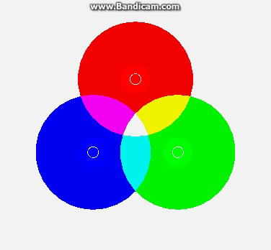
Quarks inside nucleus

Slide 38
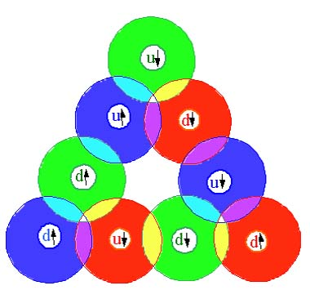
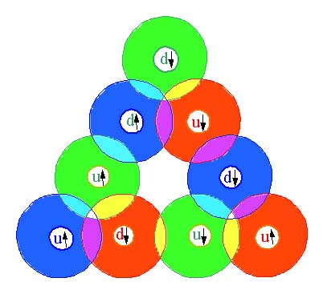
Three Nucleon Systems in SCQM
³H
³He
p
n
n
n
p
p
p
n
n
n
p
p
Quark loop 3 – body force

Slide 39
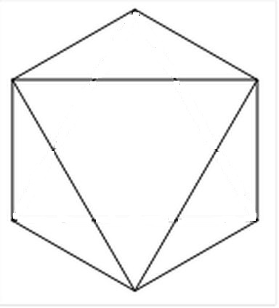
The closed shell n = 0, nucleus ⁴He
³He + neutron or ³H + proton
1
Junctures
1 ←→ 1
2 ←→ 2
3 ←→ 3
d
³H
n
4
d
u
5
u
d
p
p
u
d
u
u
2
6
3
Shell Closure
2
d
d
n
u
1
u
d
n
2
d
u
3
p
u
3
1
d
d
u
6
u
u
d
n
p
n
u
4
u
p
d
d
u
u
d
p
u
d
u
u
d
6
5
5

Slide 40
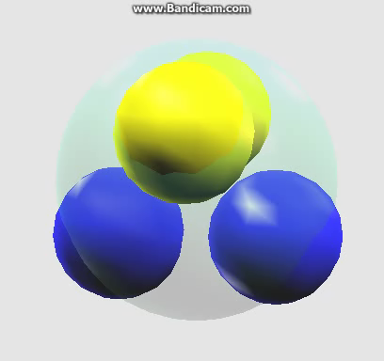
⁴He

Slide 41
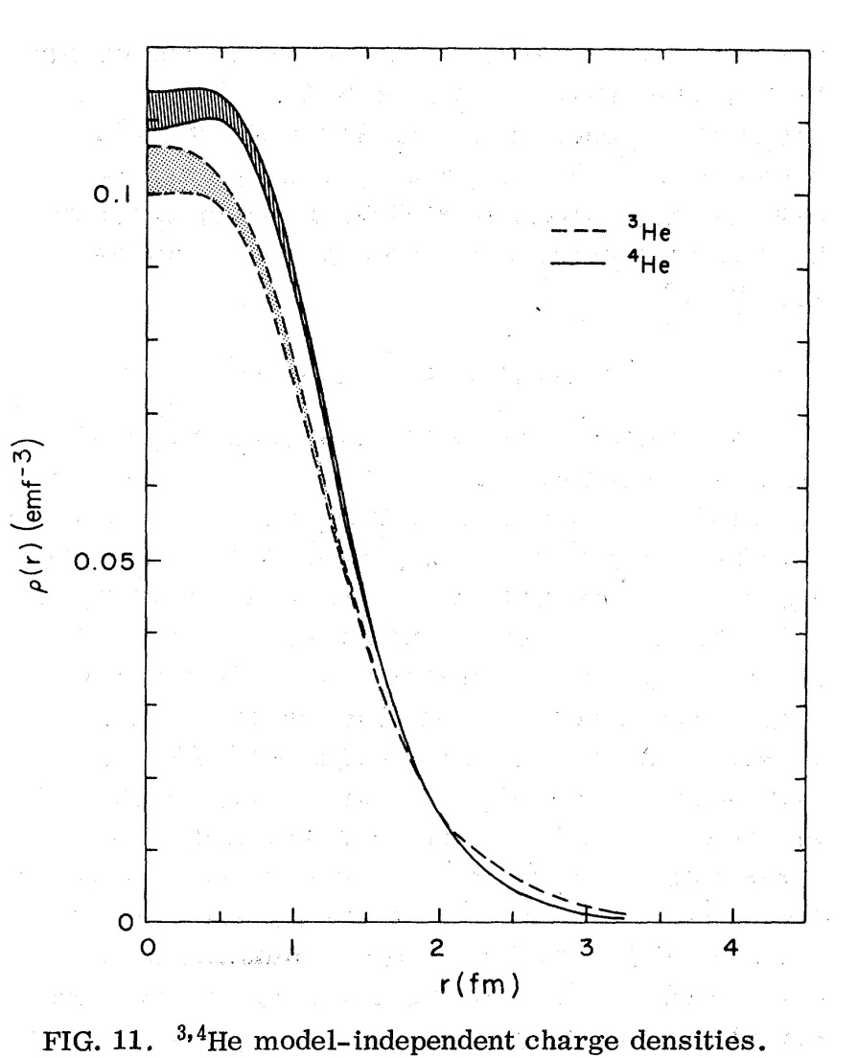
Charge distributions ³He and ⁴He
I. Sick, PRC, vol. 15, No.4; LNP, vol. 87, p.236
Notes:
He3 point-nucleon charge densities.

Slide 42
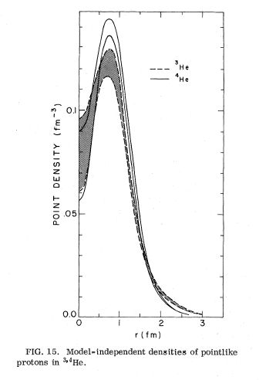
Point-nucleon charge distributions of ³He and ⁴He Hole inside ³He and ⁴He
I. Sick, PRC, vol. 15, No.4; LNP, vol. 87, p.236
Notes:
He3 point-nucleon charge densities.

Slide 43
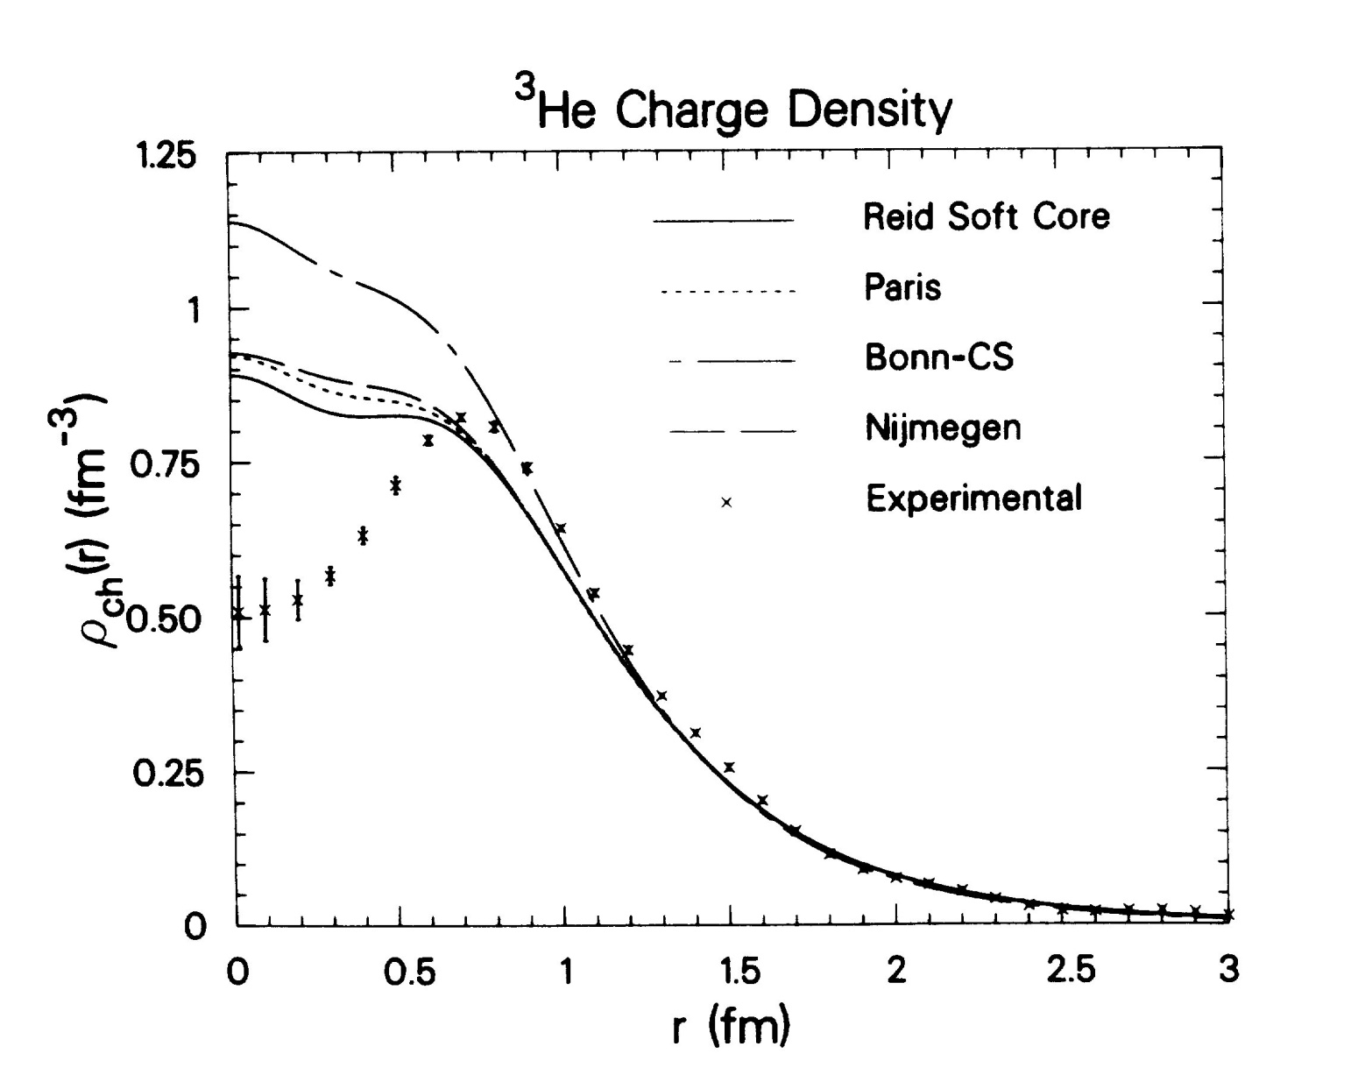
Point-nucleon charge distributions
Hole inside ³H and ³He
I. Sick, PRC, vol. 15, No.4; LNP, vol. 87, p.236
Notes:
He3 point-nucleon charge densities.

Slide 44
Binding Energy of Stable Nuclei
Experiment
Nucleus | E_{B}, MeV per junction | Number of quark loops | Free quark ends | Nuclear forces
d | 1.1 | no | 4 | 2-body (attr. + repul.)
³H | 2.83 | 1 | 3 | 2-body + 3-body (attr.)
³He | 2.57 | 1 | 3 | 2-body + 3-body (attr.)
⁴He | 7.07 | 4 | 0 | 2-body + 4-body (attr.)

Slide 45
Three Nucleon Systems in SCQM
³H
³He
Quark Loops
n
p
p
p
n
n
³He – block
³H – block
Basic building blocks
of Nuclear Structure

Slide 46
The closed shell n = 1, ¹⁶O
Shell Closure
Face of ¹⁶O octahedron
1
d
1
n
u
d
u
d
³H
u
p
n
d
u
p
d
u
d
u
u
³He
d
2
3
n
p
d
d
u
u
4
5
u
d
n
n
d
d
u
d
u
³He
u
d
³H
u
p
p
n
p
u
d
u
d
u
d
u
d
2
6
3

Slide 47
The closed shell n = 1, ¹⁶O

Slide 48
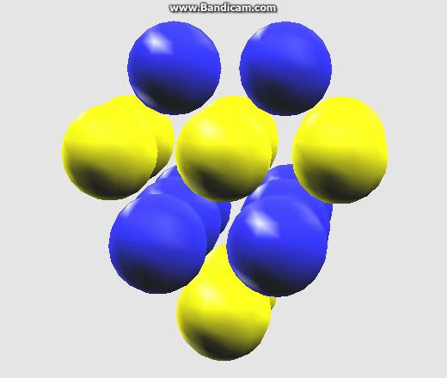
¹⁶O

Slide 49
The closed shell n = 2, ⁴⁰Ca
Shell Closure
Faces of ⁴⁰Ca octahedron
n
p
p
p
n
n
n
n
n
p
p
p

Slide 50
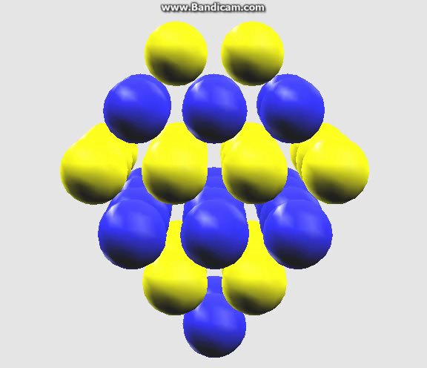
⁴⁰Ca

Slide 51
Resume on nuclear symmetry
Nucleon positions are located on the sites of face-centered cubic lattice.
Nuclei with a closure shells has a shape of tetrahedron (s-shell) and truncated tetrahadron/octahadron (p, d, f, …-shells).
Nucleons are arranged in alternating (antiferromagnetic) spin, isospin layers.
Are there any congenial nucleon-lattice models of nuclei on the market? Yes! Face-Centered-Cubic (FCC) model of N.D. Cook
SCQM is identical to FCC model of N.D. Cook!

Slide 52
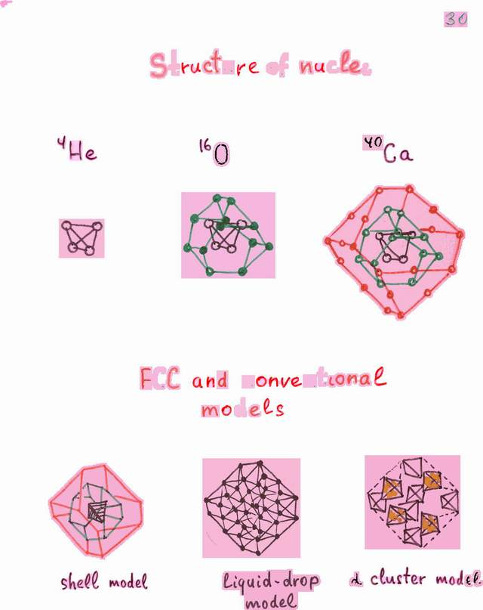
Face – Centered – Cubic Lattice Model (FCC) (N. Cook, 1987)

Slide 53



FCC Lattice Model
Particle in 3D box
For harmonic oscillator potential cartesian coordinate system
Different combinations of n_{x}, n_{y} and n_{z} that give the same total N – value denote spatially distinct “ degenerate” states, with the same energy.
If the origin of the coordinate system is taken as the center of the central tetrahedron, then the closure of each consecutive, symmetrical (x=y=z) geometrical shell in the lattice composes precisely the numbers of nucleons in the shells derived from the three-dimensional Schrodinger equation.

Slide 54
FCC Lattice Model
The principal quantum number, n
Assuming x, y and z coordinates of nucleons
are odd – integers, define n – value of k-th nucleon as
The first shell (s-shell, n=0) contains 4 nucleons with coordinates
111, -1-11, 1-1-1, -11-1.
The second shell (p-shell): 12 nucleons
31-1, 3-11, -311, -3-1-1, 1-31, -131, 13-1, -1-3-1, -113,
11-3, 1-13, -1-1-3
and so on…
Total angular momentum, j
Magnetic quantum number, m
m = |x|/2

Slide 55
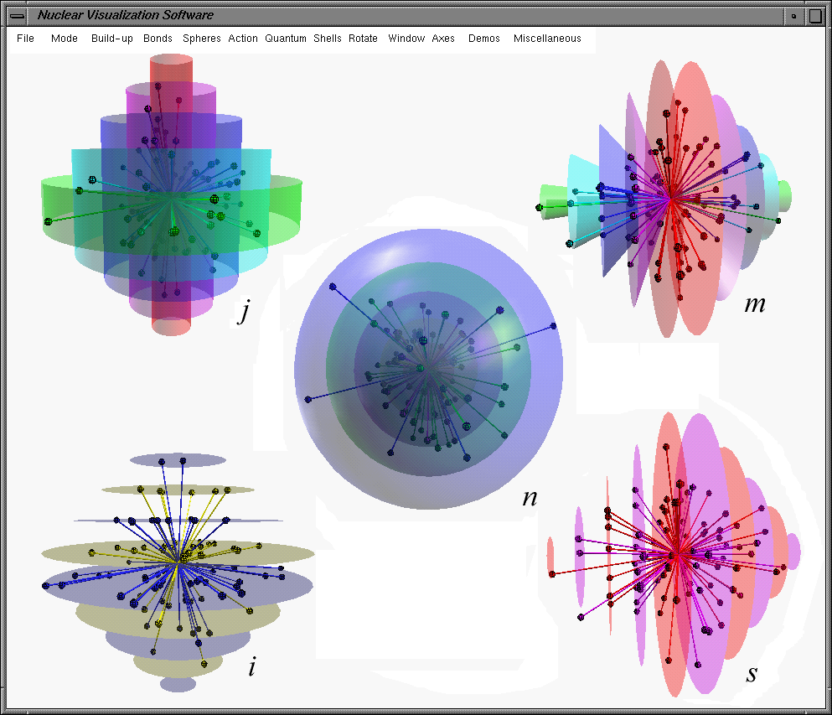
Face – Centered – Cubic Lattice
n=(x + y +z – 3)/2 = (r sinθ cosφ + r sinθ sinφ + r cosθ - 3) / 2
j = l + s = (x + y – 1) / 2 = (r sinθ cosφ + r sinθ sinφ − 1) / 2
m = x / 2 = (r sinθ cosφ) / 2

Slide 56
Resume
SCQV+FCC does not contradict SM
In both cases a mean field composed of nucleon fields can be created.
Quantum numbers of both are identical.
Differnces
In SCQV+FCC nucleons are strongly correlated
All nuclei are deformed

Slide 57
Summary
Quarks play an explicit role in formation of the nuclear structure.
Quarks and nucleons inside nuclei are correlated.
Quark loops are building blocks of nuclear binding.
Quark loops are the sources of the pairing effect.
Nuclei possess crystal-like structure:
  Nucleon centers are arranged according to FCC lattice
  Even-even nuclei are composed of virtual α-clusters
  Closed Shells = Octahedral Faces
‘Halo’ nuclei – fruits of quark-loop bindings

Slide 58


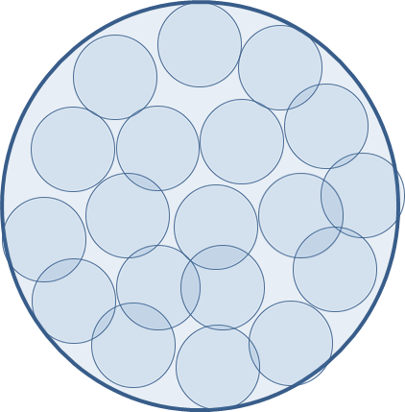

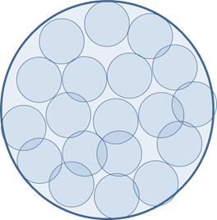

Hadron modifications in a dense nuclear matter
1. Baryonic matter under compression
Higher compression
Destruction of QCD vacuum

Slide 59
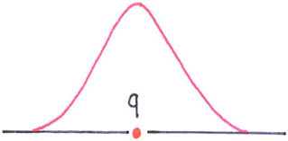
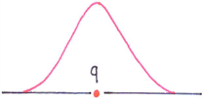
Hadron modifications in a dense nuclear matter
1. Baryonic matter under compression
Higher compression
Quark color field

Slide 60

Hadron modifications in a dense nuclear matter
1. Baryonic matter under compression
Higher compression
Decreasing quark/nucleon size
Decreasing quark/nucleon mass
Quark mass
Nucleon Collapse!
Quark size

Slide 61
Hadron modifications in a dense nuclear matter
1. Baryonic matter under compression
Higher compression → nucleon collapse!

Slide 62
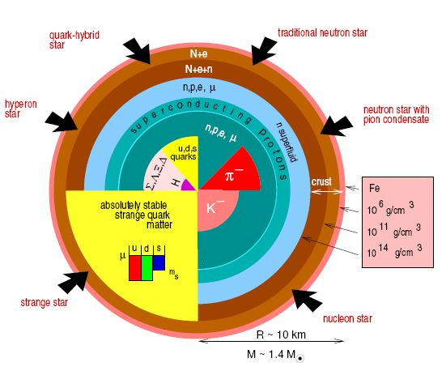
Neutron star
Gravitational compression
NS core
Neutrons?
Δ- isobars
Hyperons
…
compression
Notes:
The behaviour of strange particles in dense nuclear matter plays a crucial role in the dynamics of supernovae and in the stability of neutron stars

Slide 63
Hadron modifications in a dense nuclear medium
1. Hadronic matter at high density and temperature
Particle production in a hot and dense fireball
π – collapses → π–production is suppressed
vector mesons: - incompressible (effective cores)
ρ, ω – ‘melting’: mass dropping and width-widening; delayed hadronic decay dilepton spectra
Fireball ‘cooling’ → increased π – yield

Slide 64
Hadrons in a high dense and temperature medium
Model Consequences
Baryons transform to isobars then to hyperons
π–production is suppressed
Particle generation inside hot and dense fireball is realized mainly by vector mesons
ρ, ω – ‘melting’: mass dropping and width-widening; delayed hadronic decay (owing to 2.)
Fireball evolution:
Hadron-Resonance Liquid → Hadron-Resonance Gas

Slide 65


Hadrons in a high dense and temperature medium
Speculations (pleged)
Hadrons – topological solitons?
Conservation of topological charge
Deconfinement is forbidden → no room for QGP

Slide 66
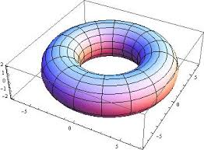

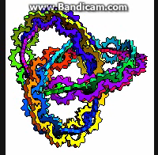
Hadrons in a high dense and temperature medium
Speculations (pleged)
Hadrons – topological solitons?
Meson – vortical torus in 4D-space
Baryon – vortical trefoil in 4D-space
Our world - 3D-hypersurface
3D analogs

Slide 67
Experiments
Energy range: √s = 3 – 11 GeV most interesting!
Enhanced yield of K⁺, φ
experiments: KaoS, AGS, NA49 at low energies of SPS
Horn-effect – irregular behaviour of K⁺/π⁺
experiments: NA49, STAR (BES RHIC)
Dilepton production
experiments: DLS, HADES, CERES, PHENIX
Projects: FAIR/CBM, NICA/MPD, BM&N

Slide 68
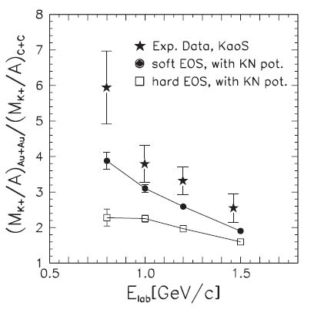
Enhanced yield of K⁺ in subthreshold kaon production
Transport models with NN-interactions
underestimate yield of K⁺ by a factor of 6
overestimate yield of K⁻
KaoS at SIS
J. Phys. G: Nucl. Part. Phys. 27 (2001) 275
RQMD:
K⁺ N repulsive potential
K⁻ N attractive potential
Momentum dependent Skyrme forces
Compression parameter
  soft ~ 200 MeV
  hard ~ 380 MeV
Notes:
Calculations were performed with two values for the compression modulus: =
200 MeV (solid line) and = 380 MeV (dashed line) corresponding to a “soft” or to
a “hard” nuclear equation-of-state, respectively. The RQMD transport model takes
into account a repulsive K+N-potential and uses momentum-dependent Skyrme forces
to determine the compressional energy per nucleon (i.e. the energy stored in the
compression).
K+ yield is sensitive to the EOS with increasing system mass and with decreasing beam energies.

Slide 69
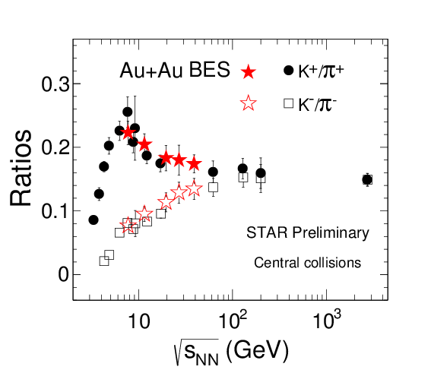
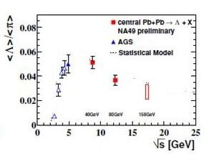
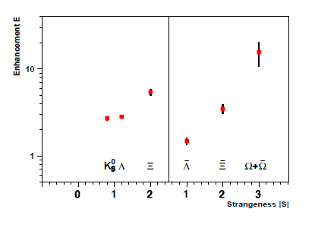
Enhansement of stangeness
Clear evidence for “horn” structure in K⁺/π⁺ at ~30 A GeV !
Non-horn structure in K⁻/π⁻
New degrees of freedom?
PbPb vs pBe SPS

Slide 70
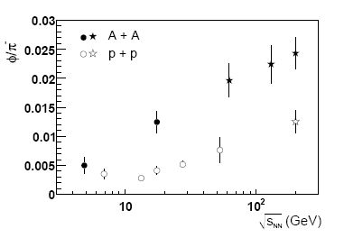
Enhancement of strangeness φ-mesons
φ/π⁻
Notes:
Calculations were performed with two values for the compression modulus: =
200 MeV (solid line) and = 380 MeV (dashed line) corresponding to a “soft” or to
a “hard” nuclear equation-of-state, respectively. The RQMD transport model takes
into account a repulsive K+N-potential and uses momentum-dependent Skyrme forces
to determine the compressional energy per nucleon (i.e. the energy stored in the
compression).
K+ yield is sensitive to the EOS with increasing system mass and with decreasing beam energies.

Slide 71
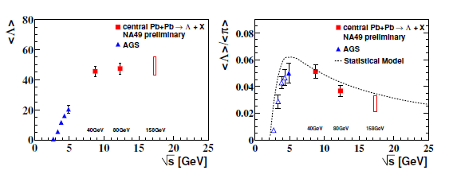
Enhanced yield of hyperons
φ/π⁻
PbPb vs pBe SPS
Notes:
Calculations were performed with two values for the compression modulus: =
200 MeV (solid line) and = 380 MeV (dashed line) corresponding to a “soft” or to
a “hard” nuclear equation-of-state, respectively. The RQMD transport model takes
into account a repulsive K+N-potential and uses momentum-dependent Skyrme forces
to determine the compressional energy per nucleon (i.e. the energy stored in the
compression).
K+ yield is sensitive to the EOS with increasing system mass and with decreasing beam energies.

Slide 72
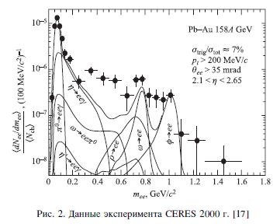
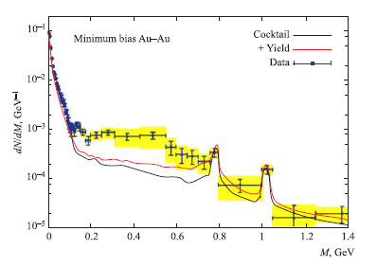
Dilepton production
Clear evidence for “horn” structure in K⁺/π⁺ at ~30 A GeV !
Non-horn structure in K⁻/π⁻
“step” in inverse slop parameter
New degrees of freedom?
Au-Au √s = 200 GeV
PHENIX

Slide 73
Thank you for your attention!

Slide 74
Nucleon Transition into Hyperon Phase
How can nucleons be converted into hyperons?
Inside highly compressed nuclear matter a strange quark-antiquark condensate < > is created.
And:
u and d quarks in nucleons are replaced by s-quarks,
s-antiquarks together with those u and d form kaons:
p, n → hyperons + kaons
the heavier quark content of a baryon, the less spatial dimensions it occupies

Slide 75
Stangeness Production in central HIC
Preferable (measurable) types of hyperons: Λ, Ξ⁻, Ω⁻
  Λ → pπ⁻
  Ξ⁻ → Λπ⁻
  Ω⁻ → ΛK⁻ (B.R. 68%)

Slide 76
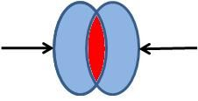
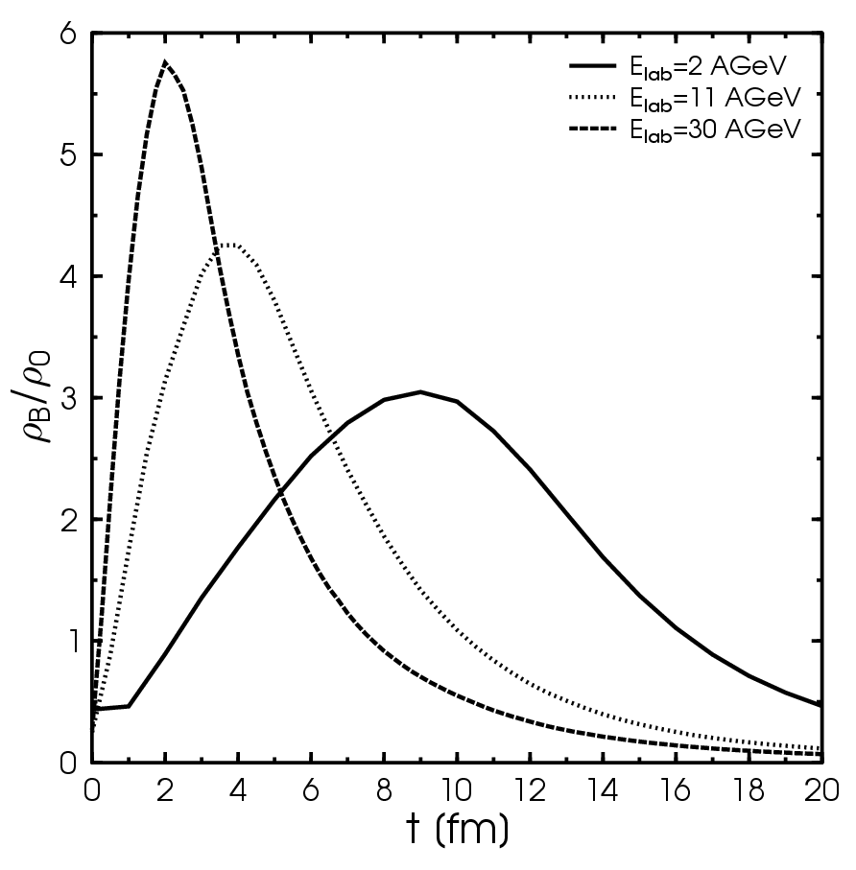
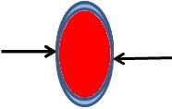

Requirements for nucleon → hyperon transition
Baryon density evolution
in central Au+Au/Pb+Pb
In overlap region nucleons are under compression and forced to occupy much less space volume.
Overlap time in c.m.s
τ_{o} = [2R_{A}/(γβ)]·b_{SP}
In Bjorken scenario b_{SP} = 1
For central AuAu-collisions ‘horn’ location:
τ_{o} ≈ 3 - 4 fm⁻¹
Above ‘horn’
τ_{o} → 0

Slide 77
Initial stage of a central fireball formation
Nucleons transformation to hyperons
P_{n→hyp} ~ (τ_{o} / τ_{re})^{c} f(ε)
τ_{ovelap} - overlap time
τ_{re} ~ 1fm⁻¹ - rearrangement time
c – adjustable parameter
f(ε) – nucleon → hyperon probability,
ε – energy density in the overlap region
Expansion of the central fireball
Non-equilibrium kinetic mechanism
~ 1/λ_{int} ~ ρσ_{hN}
λ - mean free path
σ_{hB} - hadron-baryon cross section

Slide 78
Strangeness Enhancement Mechanism in HIC
Baryon/Energy Density
Overlap Time
Strangeness/entropy
τ ~ τ₀ ≈ 3 – 4 fm⁻¹
Collision Energy
√s ≈ 7-9 GeV

Slide 79
But why ‘horn’ structure takes place for K⁺/π⁺ but not for K⁻/π⁻ ?

Slide 80
Proton-to-hyperon transition channels
Only K⁺ and K⁰ are produced
No one K⁻ is created!

Slide 81
Neutron-to-hyperon transition channels
Only K⁺ and K⁰ are produced
No one K⁻ is created!

Slide 82
Stangeness Production in central HIC
AGS, NICA, CBM, low SPS: Kinetic + Transition mechanisms: nucleon transition to (multi)strange hyperons + kaons
1 ≤ (τ_{o}/τ_{re}), τ_{re} ≤ 3 – 4 fm⁻¹
top SPS, RHIC: Only kinetic mechanism
(τ_{o}/τ_{re}) « 1
BB→ BYK⁺, BB→ BBK⁺K⁻ ,
MB→ YK⁺, MB→ BK⁺K⁻

Slide 83
Conclusion
Enhanced yield of strangeness at √s ~ 2 ÷ 10 GeV may be a manifestation of the nucleon to hyperon phase transition in a dense baryonic matter.
If it is, then the “horn-effect” should take place for the ratio K⁰/π⁰ as well.

Slide 84
What could be studied in BM&N-NICA-FAIR energy region
Enhanced yield of positive and neutral kaons near threshold.
Enhanced yield of neutral kaons (“horn-effect”)
Enhanced yield of one, double and triple strange baryons near threshold.
Electromagnetic and weak decays of hyperons below threshold
EoS near threshold
Correlation of kaons with hyperons
Elliptic and direct flows of hyperons
Possible Polarization of hyperons

Slide 85
Thank you for your attention!

Slide 86





Inelastic Overlap Function
Monte-Carlo Simulation of Inelastic Events
+ energy – momentum conservation

Slide 87

Comparison with experiments
1. EMC – effect

Slide 88

Color Transparency “Breaking”
in quasielastic scattering
p+A pp+X at θ_{cm}=90⁰
Observable:
T = σ^{A}/(Z σ^{N})

